Slide 1

Department of Information Science
Comprehensive Evaluation of Faithfulness in Summarization Models for Patent Documents
Group 7
Mentor: Huyen Nguyen
Sharath Chandra Reddy Karrepu, Yashwanth Jilla, Tarun Konda, Pramod Gangula, Muqeet Mohammad, Vishwana Gopalapuram
May 5, 2024

Slide 2
Content:
Background
Related Work
Methodology
Experiments and results
Discussion and implication
References

Slide 3


Background
Patent documents are a crucial source of technical and legal information.
But their length and complexity make them challenging to navigate and comprehend.
Summarization techniques can help condense these documents into concise summaries, improving accessibility and efficiency for researchers, legal professionals, and the general public.
Concise summaries allow decision-makers to quickly grasp the essence of a patent, facilitating faster strategic decisions regarding intellectual property management, litigation, or licensing opportunities.

Slide 4
Background (Cont.)
Challenges
Faithfulness and Hallucinations: Existing summarization models often generate unfaithful summaries that contain hallucinated or factually inconsistent information, which is unacceptable in legal and technical domains where accuracy is paramount.
Domain-Specific Language: Patent documents contain specialized terminology, complex sentence structures, and domain-specific language, making it challenging for general-purpose summarization models to capture the nuances and preserve the semantic integrity of the content.
Evaluation Metrics: Traditional evaluation metrics like ROUGE may not accurately assess the faithfulness and factual consistency of summaries, necessitating the development of new metrics tailored to the legal and technical domains.

Slide 5
Background (Cont.)
Research Objects
Evaluate the faithfulness of PLMs and LLMs in summarizing patents, focusing on accuracy and precision.
Explore the effectiveness of ROUGE, BERTscore, SummaC in automatically evaluating the faithfulness of patent document summaries..

Slide 6
Background (Cont.)
Research Contributions
Conducting a comprehensive evaluation of summarization models' faithfulness on patent documents, emphasizing the critical need for accuracy and precision in this domain.
Utilizing state-of-the-art PLMs ( T5) and LLMs ( Llama) in various settings (Finetuning, Zero-shot, Automatic evaluation) for summarization tasks.
Incorporating automatic evaluation metrics and manual assessment for clarity, accuracy, and coverage, ensuring a thorough evaluation of summary faithfulness.
Advancing natural language processing in the legal domain to potentially enhance legal document accessibility and processing efficiency for a range of stakeholders.

Slide 7
Related work
Convolutional Seq2Seq models for abstractive summarization with attention, copying, and residual connections, tested on GigaWord and DUC [1].
PGAN-ATSMT: GAN with multi-task constraints for informative, grammatical summaries, tested on CNN/Daily Mail and Gigaword [2].
Evolution of deep learning for summarization with encoder-decoder, RNNs, LSTMs, using Gigaword, CNN/Daily Mail, and ROUGE [3].
Neural model for single-document summarization with sentence extraction and compression, tested on CNN/Daily Mail and New York Times [4].
Semantic-based summarization using Word2Vec, evaluated on DUC-2007 with ROUGE [5].
Compressive approaches for cross-language summarization, improving French-to-English summaries [6].

Slide 8
Related work
Domain Concepts
Patent documents contain specialized terminology, complex sentence structures, and domain-specific language, making it challenging for general-purpose summarization models to capture the nuances and preserve the semantic integrity of the content. [5]
The paper introduces an innovative deep learning approach for multi-document summarization of patent documents, utilizing a Generative Adversarial Network (GAN) to address the unique challenges of patent language and structure.[2]

Slide 9
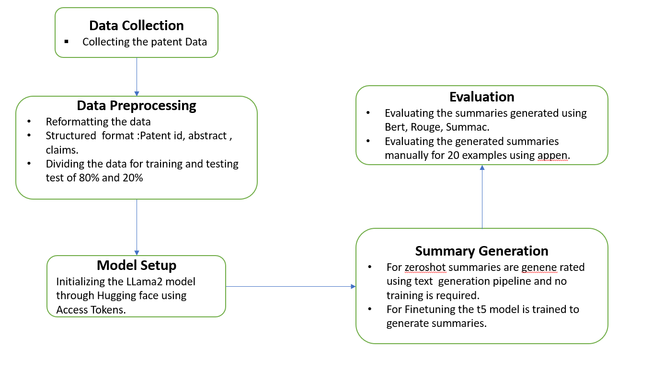
Methodology
Figure: An illustration of text summarization pipeline

Slide 10
Methodology
Data Collection:
Patent documents will be selected as the case study dataset.
The dataset will be made accessible through provided links.
It will include essential metadata, document length, and other relevant statistics.
Data Preprocessing and Cleaning:
The dataset will undergo meticulous preprocessing to reformat it into structured formats.
Key fields such as patentid, link, X (source document), and Yref (reference summary) will be extracted.
The dataset will be partitioned into an 80% training set and a 20% testing set for model evaluation.

Slide 11
Methodology
For the Zero-shot Method:
Llama 2 model will be employed through the API.
The test set will be used, with X as the document input and Y_ref for evaluation.
For Finetuning experiments:
Pre-trained Language Models (PLMs) like T5 will be used.
The models will be finetuned on the training set to enhance summarization performance.
The finetuned models will generate summaries for the test set.
Evaluation:
Automatic evaluation metrics like ROUGE, BERTscore, SummaC,will be applied on:
Generated summaries vs reference summaries .
Generated summaries vs source documents .
Manual evaluation:
Will be conducted on 20 examples to assess:
Clarity
Accuracy
Coverage
This will provide a qualitative assessment of the models' faithfulness.

Slide 12
Results
Overall Results for Zeroshot:
SummaC: 0.93, indicating high factual consistency and low hallucination.
BERT: 0.67, showing good semantic similarity with reference summaries.
ROUGE-1: 0.57, suggesting moderate unigram overlap with references.
ROUGE-2: 0.34, indicating lower bigram overlap, possibly missing key phrases.
ROUGE-L: 0.41, moderate longest common subsequence, capturing some key information.
Metrics | Summac | Rouge 1 | Rouge 2 | Rouge L | Bert
Scores | 0.93 | 0.57 | 0.34 | 0.41 | 0.67

Slide 13
Results
Overall Results for Finetuning:
Metrics | SuumaC | BERT | Rouge 1 | Rouge 2 | Rouge L
Scores | 0.92 | 0.70 | 0.53 | 0.39 | 0.45
Table: Overall results of model scores.
SummaC: 0.92, indicating high factual consistency and low hallucination.
BERT: 0.70, showing good semantic similarity with reference summaries.
ROUGE-1: 0.53, suggesting moderate unigram overlap with references.
ROUGE-2: 0.39, indicating lower bigram overlap, possibly missing key phrases.
ROUGE-L: 0.45, moderate longest common subsequence, capturing some key information.

Slide 14
Evaluation
Ideally BERT & Summac have high scores on all metrics, suggesting they capture both factual accuracy, semantic meaning, and key information from the source text.
If a model scores well on ROUGE metrics but low on BERT Score, it might be good at including keywords from the original text but struggle to capture the overall meaning.
Conversely, a model high on BERT Score but low on ROUGE might paraphrase well but miss some important factual details.

Slide 15
Discussion and implication
Based on the comparison of metrics Summac gives the highest score on the data analyzation.
BERT scores and Rouge score are corelated more compared to Summac scores.
Compressive approaches using multi-sentence compression and neural networks enhanced the quality .
Traditional evaluation metrics like ROUGE may not accurately capture semantic meaning and factual consistency.
Necessitating new metrics like SummaC for faithfulness evaluation.
The summaries generated using Finetuning , for some of the data samples the summaries generated, and reference summaries are same.

Slide 16
References
Y. Zhang, D. Li, Y. Wang, Y. Fang, and W. Xiao, "Abstract text summarization with a convolutional seq2seq model," Applied Sciences, vol. 9, no. 8, 2019.
M. Yang, X. Wang, Y. Lu, J. Lv, Y. Shen, and C. Li, "Plausibility-promoting generative adversarial network for abstractive text summarization with multitask constraint," Information Sciences, vol. 521, pp. 46–61, 2020.
D. Suleiman and A. Awajan, "Deep learning based abstractive text summarization: Approaches, datasets, evaluation measures, and challenges," 2020.
J. Xu and G. Durrett, "Neural extractive text summarization with syntactic compression," arXiv preprint arXiv:1902.00863, 2019.
M. Mohd, R. Jan, and M. Shah, "Text document summarization using word embedding," Expert Systems with Applications, vol. 143, 2020.
E. Linhares Pontes, S. Huet, J. M. Torres-Moreno, and A. C. Linhares, "Compressive approaches for cross-language multi-document summarization," Data and Knowledge Engineering, vol. 123, 2019.
M. Zhong, P. Liu, D. Qiu, X. Huang, X. Jiang, and Y. Huang, "Extractive summarization as text matching," arXiv preprint arXiv:2004.08795, 2020.
S. Mallik, S. Saha, and A. Ekbal, "Word embedding-based text summarization and evaluation," Multimedia Tools and Applications, vol. 80, no. 2, pp. 2489–2515, 2021.
S. Srivastava, S. Chaturvedi, K. M. Tripathi, S. Zaheer, R. Singh, and N. Chandra, "Deep learning for multi-document abstractive summarization: A two-level approach for patent documents," arXiv preprint arXiv:2103.14740, 2021.
A. Troshin, J. M. Sierra, V. Gurevych, and G. Glavaš, "Evaluating document similarity measures for nlp," arXiv preprint arXiv:2205.08135, 2022.

Slide 17
Thank you! Question?
Github Link: https://github.com/kannisharath/INFO-5731/tree/main/Project

